Slide 1
Fatalities and Demolitions
Israel-Palestine conflict
from 2000 to 2023
Diego J Rosa Paz
12/20/2024

Slide 2
Main Objective
To analyze the trends in fatalities and demolitions in the Israeli-Palestinian conflict between 2000 and 2023.

Slide 3
Datasets
The data in both sets comes from B’tselem– The Israeli Information Center for Human Rights in the Occupied Territories. The dataset for fatalities has 11,124 rows, each detailing an individual person. While the dataset for demolitions has 5,765 instances of a demolition undertaken by Israel in the occupied territories of Palestine.

Slide 4
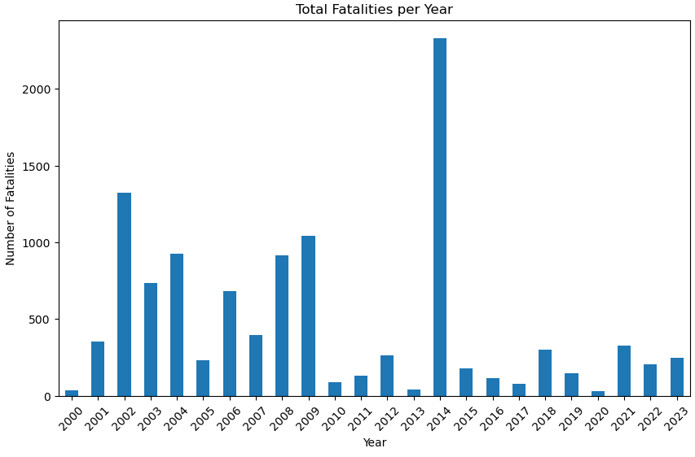
Fatalities since the Second Intifada

Slide 5
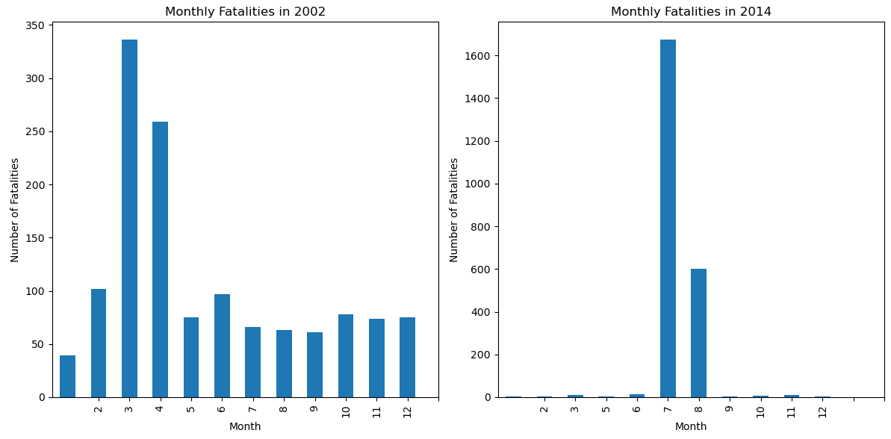

Slide 6
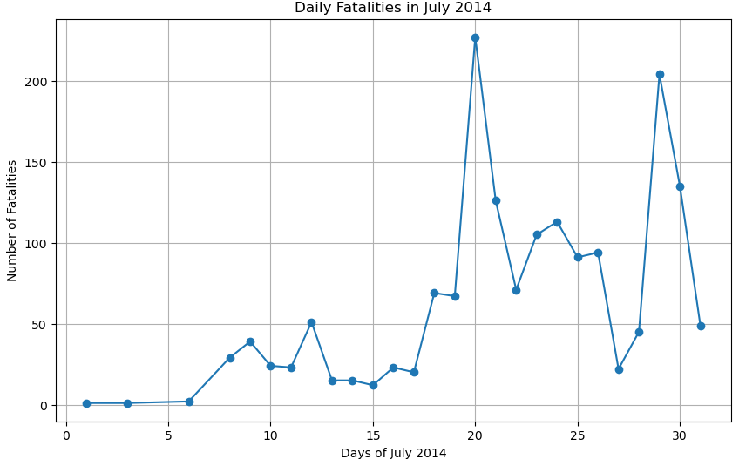

Slide 7
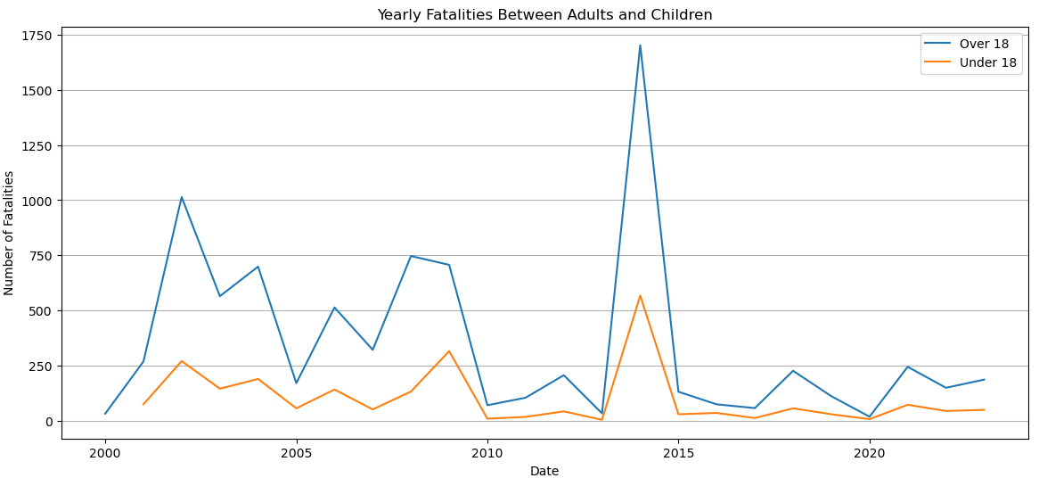

Slide 8
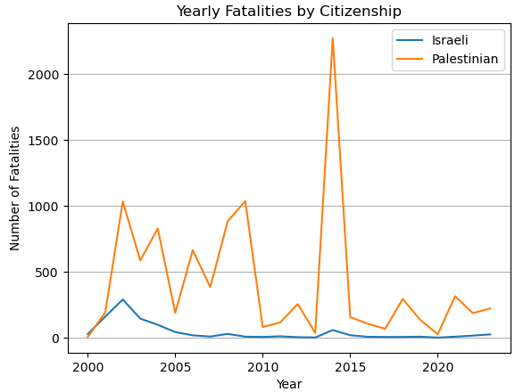

Slide 9
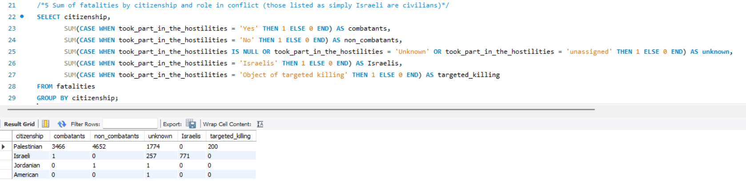

Slide 10
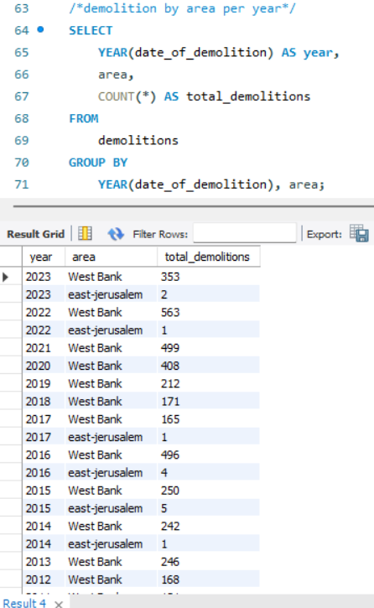

Slide 11
Some challenges with joining the datasets
Through the use of an index and by creating a separate dataset with only events in Gaza Strip and the West Bank, I was able to use a join between them to retrieve the yearly fatalities and demolitions for these areas.

Slide 12
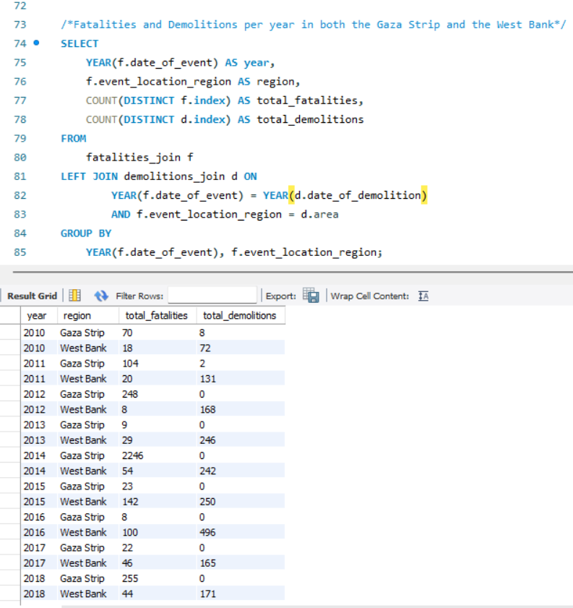

Slide 13
Conclusions
This project has helped me better manage datasets that may share similar information while not having a similar size or a clear key in common.
Through the use of mysql, jupyterlabs and kaggle, I have improved my understanding of the work that goes into managing different datasets in order to generate useful observations between them.

